Slide 1
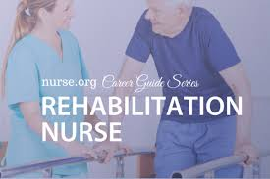
Adult Nursing(1) 2nd Stage
Rehabilitation in Nursing
Lecture 2
By
Assistant. Lecturer. Zainab Salman Dawood
Fundamentals of Nursing Department
College of Nursing
University of Basrah
University of Basrah –College of Nursing – Fundamentals of Nursing Department

Slide 2
Objectives
1- Understanding basic principles of rehabilitation
2- Understanding process of rehabilitation
University of Basrah –College of Nursing– Fundamentals of Nursing Department
2

Slide 3
GLOSSARY
Activities of daily living (ADLs): personal care activities, such as bathing, dressing, grooming, eating, toileting, and transferring.
Rehabilitation: making able again; learning or relearning skills or abilities or adjusting existing functions to meet maximum potential.
Rehabilitation nursing: a branch of nursing focused on providing care to patients who have been incapacitated by illness or injury or are facing potentially life-altering health conditions throughout their lifespan.
University of Basrah –College of Nursing– Fundamentals of Nursing Department
3

Slide 4
Impairment: loss or abnormality of psychological, physiologic, or anatomic structure or function at the organ level.
Debilitated: impaired strength, weakened, injured, disabled.
Assistive technology: any item, piece of equipment, or product system that is used to improve the functional capabilities of individuals with disabilities; this term encompasses both assistive devices and adaptive devices.
University of Basrah –College of Nursing– Fundamentals of Nursing Department
4

Slide 5
Introduction
Rehabilitation is an integral part of nursing because every major illness or injury carries the threat of disability or impairment. People with disabilities and their families experience better health and functioning when they are partners in rehabilitation, so educating people with disabilities is essential for developing knowledge and skills for self-help, care, management, and decision-making.
University of Basrah –College of Nursing– Fundamentals of Nursing Department
5

Slide 6
Aims of rehabilitation
1) The prevention, diagnosis and treatment of concomitant medical problems such as co-morbid illnesses, complications.
2) Training for maximum functional independence.
3) To support psychosocial coping and assist in the adaptation of patients and families.
4) To support the return to community life.
5) To improve the quality of life of patient and family members who provide care.
University of Basrah –College of Nursing– Fundamentals of Nursing Department
6

Slide 7
Principles of Rehabilitation
The principles of rehabilitation are basic to the care of all patients, and rehabilitation efforts should begin during the initial contact with a patient. These principles involves:
1) Rehabilitation encompasses all domains of personhood: physical, psychosocial, emotional, cultural, spiritual, and cognitive.
2) Rehabilitation is a continuous process.
3) Rehabilitation requires active patient participation.
4) Rehabilitation is goal directed.
5) Rehabilitation requires multi-professional and interdisciplinary teamwork.
University of Basrah –College of Nursing– Fundamentals of Nursing Department
7

Slide 8
Rehabilitation Team
The interdisciplinary team members include health professionals who make unique contributions to the rehabilitation process. Communication, collaboration, understanding of roles, and educational levels of team members are all important
considerations in building an effective interdisciplinary team.
University of Basrah –College of Nursing– Fundamentals of Nursing Department
8

Slide 9
Nurses
Physicians
Physiatrists
Physical therapists
Occupational therapists
Speech–language therapists
Psychologists
Social workers
University of Basrah –College of Nursing– Fundamentals of Nursing Department
9

Slide 10
Process of Rehabilitation
Rehabilitation process involves:
Identification of a person’s problems and needs.
Relating the problems to relevant factors of the person and the environment.
Defining rehabilitation goals
Planning and implementing the measures
Assessing the effects
University of Basrah –College of Nursing– Fundamentals of Nursing Department
10

Slide 11
Identify problems and needs
Relate problems to modifiable and limiting factors
- Define target problems
- Select appropriate measures
Plan, implement, and
coordinate interventions
Assess effects
University of Basrah –College of Nursing– Fundamentals of Nursing Department
11

Slide 12
General responsibilities of the rehabilitation staff nurse
1) Possesses the specialized knowledge and clinical skills necessary to provide care for people with physical disability and chronic illness
2) Coordinates educational activities and uses appropriate resources to develop and implement an individualized teaching and discharge plan with clients and their families
3) Performs hands-on nursing care by utilizing the nursing process to achieve quality outcomes for clients
University of Basrah –College of Nursing– Fundamentals of Nursing Department
12

Slide 13
4) Coordinates nursing care activities in collaboration with other members of the interdisciplinary rehabilitation team to facilitate achievement of overall goals
5) Acts as a resource and a role model for nursing staff and students and participates in activities such as nursing committees and professional organizations that promote the improvement of nursing care.
6) Applies nursing research to clinical practice and participates in nursing research studies
University of Basrah –College of Nursing– Fundamentals of Nursing Department
13

Slide 14
Areas of specialty rehabilitation
Although rehabilitation must be a component of every patient’s care, specialty rehabilitation programs have been established in general hospitals, and outpatient facilities.
Stroke recovery programs and traumatic brain injury rehabilitation
Spinal cord injury rehabilitation programs
Orthopedic rehabilitation programs
Cardiac rehabilitation
Pulmonary rehabilitation programs
Comprehensive pain management programs
Comprehensive burn rehabilitation programs
Pediatric rehabilitation programs
University of Basrah –College of Nursing– Fundamentals of Nursing Department
14

Slide 15
Assessment of functional capacity
Comprehensive assessment of functional capacity is the basis for developing a rehabilitation program. Functional capacity is a person’s ability to perform activities of daily living and independent activities of daily living.
University of Basrah –College of Nursing– Fundamentals of Nursing Department
15

Slide 16
Activities of daily living | Independent activities of daily living.
Bathing Dressing Getting in or out of bed Using the toilet Eating | Cooking Cleaning Shopping Managing personal finance Developing social and recreational skills
University of Basrah –College of Nursing– Fundamentals of Nursing Department
16

Slide 17
Although there are many disease - specific tools used to assess the patient’s functional ability, some frequently used generic measures include the following:
1) The PULSES profile: is used to assess:
Physical condition
Upper extremities functions
Lower extremities functions
Sensory function
Excretory function
Social and mental status
* Each of these areas is rated on a scale from one (independent) to four (greatest dependency).
University of Basrah –College of Nursing– Fundamentals of Nursing Department
17

Slide 18
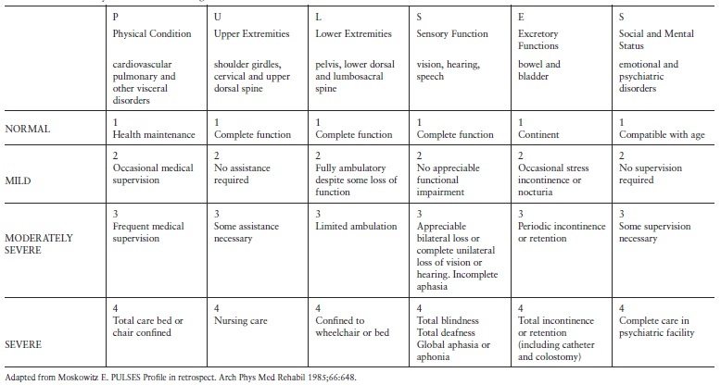
University of Basrah –College of Nursing– Fundamentals of Nursing Department
18

Slide 19
2) The Barthel Index: is used to measure the patient’s level of independence in activities of daily living, toileting, transfers, and ambulation (or wheelchair mobility). This scale does not address communicative or cognitive abilities.
University of Basrah –College of Nursing– Fundamentals of Nursing Department
19

Slide 20
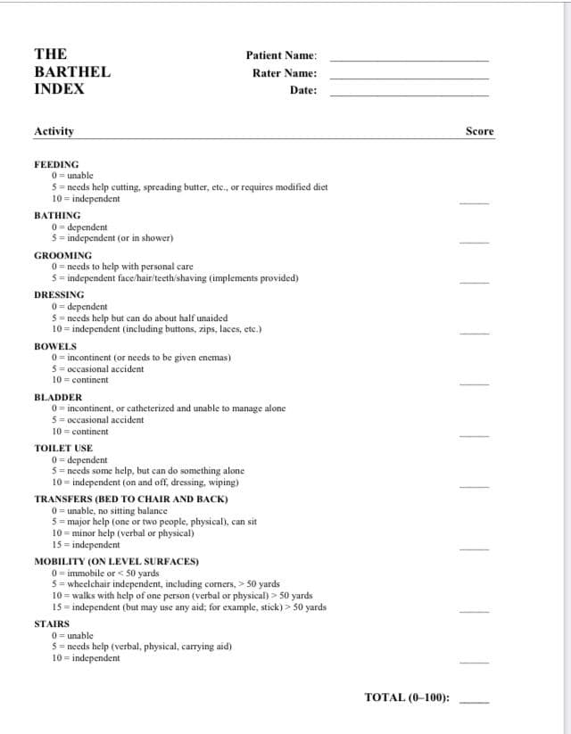
University of Basrah –College of Nursing– Fundamentals of Nursing Department
20

Slide 21
3) The Patient evaluation conference system (PECS): which contains 15 categories, is a comprehensive assessment scale that includes such areas as medications, pain, nutrition, psychological status, vocation, and recreation.
University of Basrah –College of Nursing– Fundamentals of Nursing Department
21

Slide 22
Summary
Rehabilitation is an integral part of nursing because every major illness or injury carries the threat of disability or impairment.
Comprehensive assessment of functional capacity is the basis for developing a rehabilitation program.
University of Basrah-College of Nursing– Fundamentals of Nursing Department 22

Slide 23
Thanks
University of Basrah –College of Nursing– Fundamentals of Nursing Department
23

